Slide 1
Disease Classification
By Sophia Szady and Jack Aleksa

Slide 2

Introduction
Advancements in tech have led to innovations in medicine
AI has emerged as a powerful tool in transforming healthcare
AI offers remarkable potential accuracy and streamlined workflows
Harnessing the power of AI, professionals can leverage vast amounts of data using complex algorithms to help make informed decisions

Slide 3
Disease Prediction Using Machine Learning
Consists of 41 diseases with a total of 132 symptoms
Download 16577 times on Kaggle
4692 different cases
Source: Kaggle
User: kaushik268
Info: Student at Nirma University in Ahmedabad, Gujarat, India

Slide 4
Solutions
Previous Solutions:
CatBoostClassifier, Decision Tree Models, Random Forests, Boosted Trees, Naives Bayes, SVM
Often evaluated using F1 scores
Higher accuracies reaching 100%
Beyond scope of our course
Our solution:
LSTM model with a Dense layer and a softmax activation function
Compiled using categorical cross entropy and the adam optimizer
Accuracy reaching 81%

Slide 5
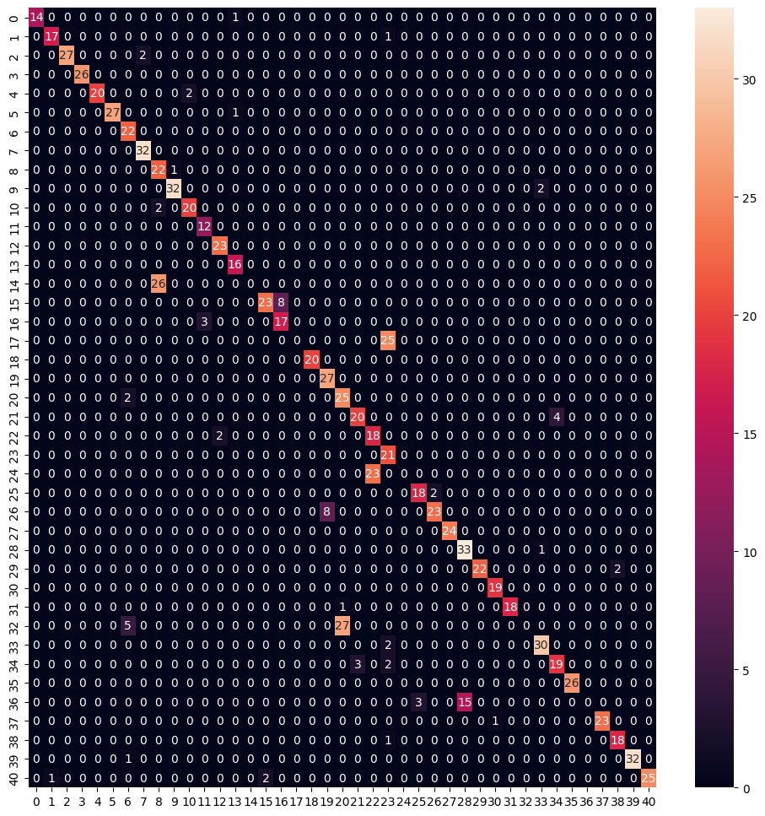
Evaluation Methods:
Keras evaluate model method used for testing the trained model
Returned loss and accuracy of the model
Seaborn heatmap and SKlearn confusion matrix used for evaluation
Parallel use of heatmap and confusion matrix
Maps all different cases from the testing set in the trained model

Slide 6
.7399 loss
.8167 accuracy
Model was incredible volatile; 25 epochs; no early stopping; overfitting in early testing

Slide 7
Discussion
5 diseases in the model were misdiagnosed
Chicken Pox diagnosed as Drug Reaction
Explained by overlapping symptoms of itchiness and skin rash
Jaundice being diagnosed as Tuberculosis
Both resulting in yellowing, jaundice for skin and tuberculosis for eyes
Other 3 misdiagnoses attributed to the limiting of epochs in training the model
In applying a similar to clinical practice the impact of misdiagnoses are much greater
Depending on the disease causes type I or type II errors to be worse

